Slide 1
JUMPSTART & JUNIOR PARENT MEETING

Slide 2
Welcome to Starskate Jumpstart and Junior Programming
Your skaters are currently on the Starskate Pathway in the learn-to-train level as part of the Sport for Life’s Long-term development
When logged into your account with Skate Canada you can read more on the Starskate Pathway
Go to skatecanada.ca/members to create an account in your child’s name. This way you will be able to see their STARskate Achievements and follow their official progress.

Slide 3
Assessments
Skaters at the Jumpstart level will complete their Canskate Badges while learning to figure skate. These are listed under achievements at the club level on our website.
Junior Skaters will start or be working on Star 1 – 2 assessments in dance, skills and freeskate. It takes a lot of practice to accomplish the skills in each area.
The Starskate assessments cost $12 per assessment which goes to Skate Canada.
Coaches will provide you with an envelope and instructions for returning once your skater is ready to take an assessment.

Slide 4
Events
We encourage all skaters at this level to participate in appropriate level events that are offered to further their development.
JUMPSTARTS
Can register for our club “Canskate Merit Events”
As part of Skate Canada’s long-term-development, these type of events get your skater ready for the learn-to-train at the Junior level.
Take advantage of any performance opportunity like our Holiday Performance Food Bank Drive or our Ice Gala at the end of the season.
If your skater moves up to Junior, they will have other opportunities as well.
Join the Synchro Session on Sundays. As your skater does not have a regular jumpstart session this day, this will give them the opportunity to work and develop their skating skills while having fun learning on a team. More on synchro later…..

Slide 5
Events for Juniors
Your first event is the 2023 PEI Star 1 – 4 Fall Competition on November 25th
This is an important event and took a lot to finally have a Fall Competition here on the island, so we encourage all to attend and enjoy the experience.
Registration opens on October 18th. We encourage all to register early as it may fill very quickly.
Coaches will advise you as to the level your skater should enter be it STAR 1 or STAR 2.
For new skaters at the Starskate level, STAR 1 is very similar to a club merit event but on a larger scale with other skaters across the island at the event. Skaters are not ranked at these levels. They all get official’s feedback and a bronze, silver or gold rating. Star 2’s skate a solo. There are also team and synchro events offered.
Please read the announcement ahead of the opening date. Got to Skate Canada PEI for details at https://www.skatecanadapei.ca/
In February will be the 2024 PEI ADL STAR 1 - 3 Championships
Other competitions are offered off-island and skaters can enter any “invitational event”. *talk to your coach first
The Club will pay $100 funding towards one off-island event if you choose to go to one of these events.
Competitions can be found on our Links-Gotta See It tab on our main menu bar, use the drop-down menu to go to events & competitions.

Slide 6
Competition Hosts
Sherwood Parkdale Skating Club is part of the Island Skating Academy for programs in the off-season.
We will be hosting the 2023 PEI STAR 1- 4 Fall Competition as well as the 2024 Starskate and Synchro Championships with Skate Canada PEI.
For the Fall Competition we have more responsibilities and duties to cover as volunteers.
Doreen Pippy is SPSC’s Event Coordinator and will be the lead for our club along with Laurie Godfrey (for ISA &the PEI Section) and a CSC representative.
Doreen has information for our members for areas of help and volunteer hours for the event.
We kindly thank you ahead of time for your consideration and generosity.

Slide 7
Synchro
All Jumpstart, Juniors and Intermediate Skaters are encouraged to take part in Synchro
As part of the Skate Canada curriculum, this session is an excellent opportunity to develop skating skills
For the skater’s this is a great opportunity to engage in a team environment
The cost is $175 total with a Starskate Registration or $29 a month on installments.
This includes ice time, coaching, off-ice classes, competition registration fees
Skaters will also receive a free Sychro Jacket *if sufficient participants for a team
Toonie Days in September and popcorn sales at events goes into our Synchro fund to help off-set costs

Slide 8
Healthy Kids! Active Kids! Fundraiser
This season the fundraiser is a “surf and turf” with items from Steerman’s Quality Meats and mussels from PEI Aqua Farms.
We have been hit hard with increased operating expenses from all areas this season ie ice costs, insurance, coaching, supplies etc and we DO NOT want to pass these increases off to you by further increases to registration fees. Sports are expensive enough for families and we would rather put food on your tables than increase fees.
If you want to fill your freezers and you purchase more than 10 items, you will receive a credit on your personal account as well as helping the club overall.
Extra order forms are available. We will also email out a copy for printing or using digitally.

Slide 9
Reminders
THE CALENDAR tab in your account
will show all your registered skating days, events etc.
This is the best “go-to”. It the event of any changes, it will show here first.
Off-ice classes are included in your registration and an important part of a skater’s training. If possible ,please bring a yoga mat, skipping rope, running shoes and a water bottle. A “spinner” is also very useful.

Slide 10
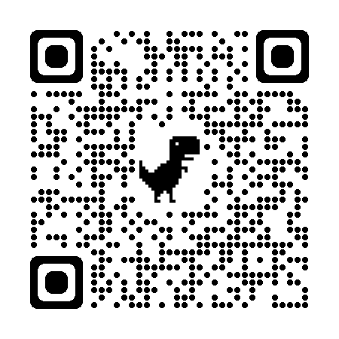
Club Apparel
We have a store available through Allstar Cresting
There are t-shirts, hoodies, outdoor jackets and more – Get in the spirit with quality merchandise. 10% goes to the club.
https://allstarcresting.ca/
We now have youth size club competition/practice jackets available for order. Reach out to us at office@sherwoodparkdaleskatingclub.com if you are looking for an on-ice/competition jacket. Adult sizes will still be ordered through lululemon if a minimum number are required.
Mittens and gloves as well as skate guards are also still available on site.

